Slide 1
Problematic procrastination

Slide 2
Intro
On the agenda during this workshop:
What is problematic procrastination?
How does procrastination affect me?
What can and cannot I tackle?
What works, what doesn’t?
We tackle procrastination!
Make timely adjustments

Slide 3
Aha moments and action points – the notebook
Ahaaa moments (insights for formatting ‘defer action plan’) | Action points
Behaviour you can unlearn | If you can perform it within two minutes, do it immediately.
I am a passive fear of failure procrastinator | Making a list of my internal distractors and hanging it on the wall

Slide 4
What is problematic procrastination?
Everyone puts something off sometimes
Procrastinating can become a (persistent) habit
Procrastination can become a problem when:
You keep putting off study tasks, despite your good intentions;
It causes you to underperform and fail to meet your deadlines and goals;
Your procrastination behaviour thus negetively affects your well-being.
It is a source of conflict with others (fellow students, teachers, parents, internship supervisor…).
You are not born with it → learned
So you can also unlearn it

Slide 5
What is problematic procrastination?
There are different types of procrastination
These indicate the reason why you procrastinate
Assignment: Which checks apply to you? (notebook)
Any other additions not included in the brief?

Slide 6
What is problematic procrastination?
Types of procrastination
‘Passieve faalangst’: het verhaal van Sofie ( weinig vertrouwen in het kunnen, 30 min zitten staren op 1 blad, naar TV serie kijken omdat het nu toch niet lukt)
‘De zoekende student’: het verhaal van Steven ( sommige vakken intressant, sommige
Optimistic procrastinator | Passive fear of failure | Seeking student
Sometimes worries but often still experiences plenty of time. Chooses activity on a moment’s notice. Choice is determined by degree of importance. Delivers short-term good feeling. | Low confidence in own ability. Causes frustration leading to a move to another activity. Not dwelling on bad feelings for a while. | Doubts make it difficult for him/her to take action. E.g.: Is this the right study methodology? This is not a fun subject. Is the course right for me then? Avoids difficult questions, gets back to feeling calmer.

Slide 7
What is problematic procrastination?
Home assignment: Why am I procrastinating?
‘
Date of postponement | Why did I procrastinate? | Did I perform the deferred task at a later time and exactly the same amount of time to do so?

Slide 8
Overview
‘
What is problematic procrastination?
How does procrastination affect me?
What can and cannot I tackle?
What works, what doesn’t?
We tackle procrastination!
Make timely adjustments

Slide 9
How does procrastination affect me?
Assignment: Evolution meter and desired situation
NOW
1
Procrastination dominates my entire life
4
10
I master my procrastination in every situation
FURUTRE
8
When I resolve to do something, I effectively do it.
I am again satisfied with the tasks I submit.
I am more cofident in my own abilities.

Slide 10
Overview
‘
What is problematic procrastination?
How does procrastination affect me?
What can and cannot I tackle?
What works, what doesn’t?
We tackle procrastination!
Make timely adjustments

Slide 11
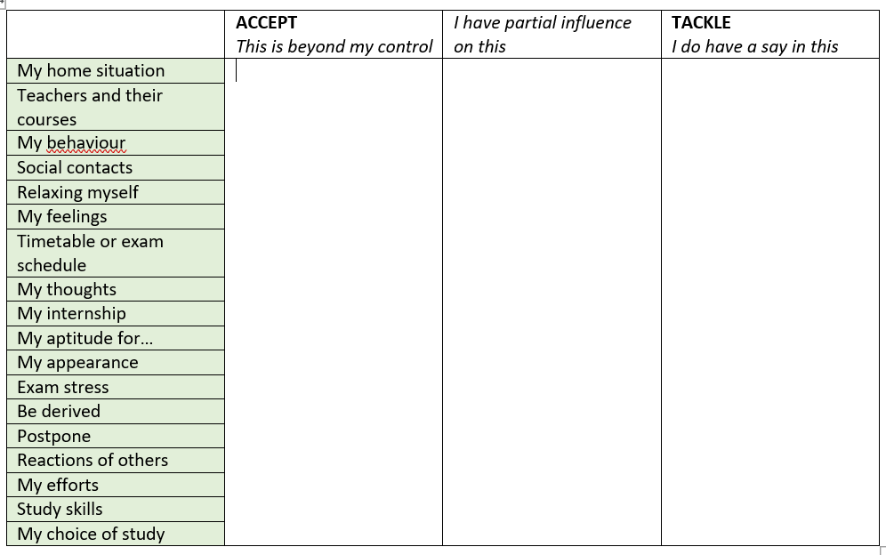
Tackle or not
Assignment:

Slide 12
Tackle or not
What you have little or no ability to influence | What you can influence
My home situation | Relaxing myself
Teachers and their courses | My behaviour
My internship | Comments from others
Examination regulations and timetables | Social contacts
My aptitude for… | My choice of study
My appearance | Being distracted
 | My thoughts
 | Postpone
 | Exam stress
 | Study skills
 | My commitment

Slide 13
Overview
What is problematic procrastination?
How does procrastination affect me?
What can and cannot I tackle?
What works, what doesn’t?
We tackle procrastination!
Make timely adjustments

Slide 14
What works, what doesn’t?
Assignment: What is definitely not working for me?
Pressure form my environment to study (by e.g. my parents).
Create a general schedule or a to-do list to stop looking at it.
Reassuring myself by thinking: “Tomorrow or next week I’ll definitely do it…”
First doing all sorts of things only to find that it has already become very late.
Others who say: “That it will work out.”
Contact a friend who also often procrastinates to do something together.
Leaving Outlook, Facebook, Youtube… open while I study, in order to have some distractions in between.
Telling myself that a task is not important anyway or will not take long. This without checking or thinking about what exactly the task entails and what I need to do for it.
Other?

Slide 15
What works, what doesn’t?
Assignment: What does seem to work?
Go to class (follow online at the time)
Paying attention in class and taking notes
Note new assignments and deadlines immediately in my diary
Creating tasks
Letting others know when I take time to study
Creating a to-do list so that I know very specifically what I need to do
Breaking down a big task into smaller parts and seeing in concrete terms what I will do when
Making an achievable and concrete schedule and training myself step by step and day by day to follow it up
Discussing with someone who listens to me what I am currently struggling with, so that my courage to start working on it grows
Asking someone for an explanation when I don’t understand something instead of worrying about it
Whatever can distract me to the side and put away when I want to study
Calling a friend or classmate to (re)find courage or to ask a question when things get tough

Slide 16
What works, what doesn’t?
Home assignment: Who do you think handles it well?

Slide 17
Overview
Wat is problematisch uitstelgedrag?
Welke invloed heeft uitstelgedrag op mij?
Wat kan ik wel en niet aanpakken?
Wat werkt, wat niet?
We pakken het uitstellen aan!
Stuur tijdig bij
What is problematic procrastination?
What can and cannot I tackle?
We tackle procrastination!
How does procrastination affect me?
What works, what doesn’t?
Make timely adjustments
Importance of motivation Tackling the G’s
Process of change My competences

Slide 18
We tackle procrastination! – Importance of motivation
Importance of own motivation for training
Why am I studying this programme?
Because otherwise my parents will be disappointed if I don't get this degree.
To show that I can cope with the level of higher education.
Bacause I need this degree for the sector I would like to work in.
Because I find the course interesting.

Slide 19
We tackle procrastination! – Importance of motivation
Penalty
Reward
Expectation
Shame
Guilt
Self-esteem
Personal
Meaningful
Relevant
Fascinated
Interest
Fun
Obligation
Budy
Stress
Benevolent
Free
Controlled motivation = mustivation
Autonomous motivation

Slide 20
Overview
Wat is problematisch uitstelgedrag?
Welke invloed heeft uitstelgedrag op mij?
Wat kan ik wel en niet aanpakken?
Wat werkt, wat niet?
We pakken het uitstellen aan!
Stuur tijdig bij
Importance of motivation Tackling the G’s
Process of change My competences

Slide 21
We tackle procrastination! – process of change
Event: Within three days, you have to submit an important assignment for which you were given a week.
Thoughts: What an annoying assignment. I don’t feel like doing this at all now because I have agreed to go out with friends. Tomorrow I’ll fly in and it will be fine.
Feelings: Your restlessness disappears and you feel quite relaxed.
Behaviour: You go out that night. The next day, you are tired and decide to watch Netflix in the evening. On the last night, you kick into gear.
Consequence: You have to work until a hole in the night to finish the assignment. You are not satisfied with the result. You feel quilty for not starting earlier and curse at yourself.

Slide 22
We tackle procrastination! – process of change
Relationship between

Slide 23
How does procrastination affect me?
‘
Wat is problematisch uitstelgedrag?
Welke invloed heeft uitstelgedrag op mij?
Wat kan ik wel en niet aanpakken?
Wat werkt, wat niet?
We pakken het uitstellen aan!
Stuur tijdig bij
Importance of motivation Tackling the G’s
Process of change My competences
BEHAVIOUR
THOUGHTS
FEELINGS

Slide 24
We tackle procrastination!
Breaking habits
50% of our daily actions are determined by fixed habits.
They are well trained by a lot of repetition.
Concrete and achievable plan of action needed.
Lots of repetition.
Visualising.

Slide 25
We are tackling procrastination: changing our BEHAVIOUR
Pros and cons of procrastination and change
Assignment: Pros and cons of postponing
Short-term positive effect: doing something more fun
Long-term negative effect: underachievement, failure, guilt, negative effect on relationships, self-image and stress
Assignment: Pros and cons of tackling procrastination
In the beginning, you will only see/experience the drawbacks. Takes time and effort.
In the long run: more satisfied, proud, enjoy earned leisure time more
Write it on a or make a

Slide 26
We are tackling procrastination: changing our BEHAVIOR
Pros and cons of procrastination and change
Benefits of delaying | Disadvantages of delaying
I spend a lot of time on social contacts and all kinds of activities (e.g. sports, going out, youth movement, friends, hobby…). | I am more likely to fail in my studies.
Disadvantages of behavioural change | Benefits of behavioural change
I can be less engaged in relaxing activities that make me feel good here and now. | I increase my chances of passing with every class attended, every task completed, every hour of studying.

Slide 27
We are tackling procrastination: changing our BEHAVIOR
Where does my time go?
Lots of overestimating and underestimating:
Time there is;
The task you need to do or the course you need to study;
Of yourself and your capacity (how fast you think you can get something done).
Time tracking app: Toggl
Categories
Lesson/internship
Studies/assignments
Relaxation
Basis needs
Sleep
Student job
Travel
Unfocused
Cut-off time

Slide 28
Overview
We tackle procrastination: changing behaviour
Pros and cons
Where does my time go?
Study approach
Study environment
Study method
Study organisation
MAKE A CHANGE IN

Slide 29
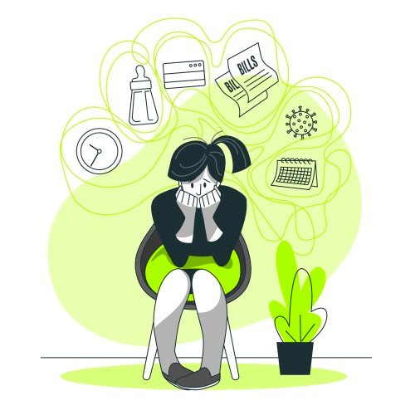
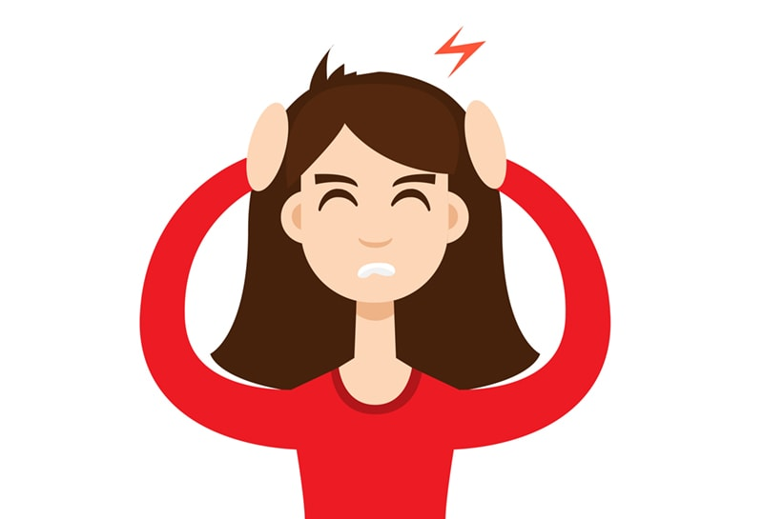
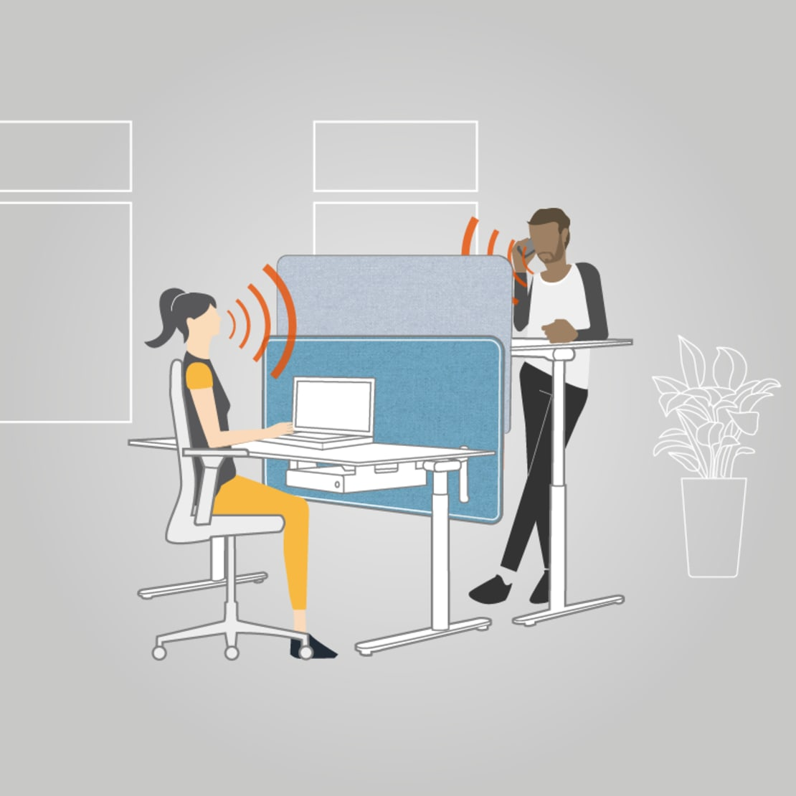
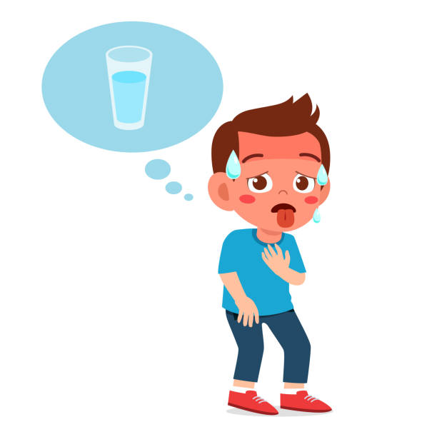
We are tackling procrastination: changing our BEHAVIOR
Study approach
Study environment
Distractors

Slide 30
We are tackling procrastination: changing our BEHAVIOR
Study approach
Study environment
Interne afleiders | Externe afleiders
Internal distractors
External distractors

Slide 31
We are tackling procrastination: changing our BEHAVIOR
Assignment: What are your internal and external distractors? What are your habits?
Installing instigators
Start running: Download Start 2 Run app, schedule fixed time, put running shoes in clearly visible place
Quit smoking: put ashtrays out of your sight, stand with friends who do not smoke during breaks, place nicotine patches clearly visible in bathroom, smoking programme reminders via email you receive daily
Eating healthier: putting fruit bowl clearly visible, not having food in the house that is not healthy, eating first before going to the shop
Task: Changing my study environment – installing instigators
Creating helpful environment to get ahead of old habits and install new ones

Slide 32
We are tackling procrastination: changing our BEHAVIOR
Study approach
Study environment
External and internal distractors
Digital tools
Get cold turkey
StayFocusd op de Chrome internetbrowser
FocalFilter voor alle internetbrowsers op Windows
SelfControl voor Mac

Slide 33
Overview
We tackle procrastination:
changing behaviour
Pros and cons
Where does my time go?
Study approach
Study environment
Study method
Study organisation
External and internal distractors
Digital tools

Slide 34
We are tackling procrastination: changing our BEHAVIOR
Study approach
Study method

Slide 35
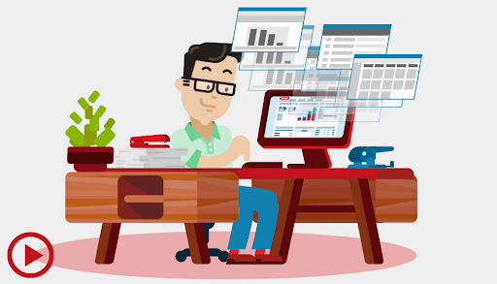
We are tackling procrastination: changing our BEHAVIOR
Study approach
Study organisation – processing time recording assignment
What stood out about Marie?
Blue and yellow time blocks: relaxation, daydreaming and trashing
Barely room where she effectively studied = 3 hours
Procrastination excuses
Doens’t necessarily spend a lot of free time but wants to use idle time more effectively
Too preoccupied with why she will now do something later instead of effectively doing something
Wants to boost study time through planning

Slide 36
We are tackling procrastination: changing our BEHAVIOR
Study organisation – processing time recording assignment
For your information, a full week (7x24h) has 168 hours. When you sleep 8h per night, 112 hours remain.
Step 1: What is allowed to stay that way?
Step 2: What do you want different? Which colour category takes up more time than is good for you? (several are possible)
Step 3: What is your ultimate goal? With how many study hours per week will you be satisfied? Satiesfied: balance between enough free time for you and enough study time to succeed?
Step 4: What is the first step you want to take? How many study hours do you want to get next week?
Step 5: Where can and will you get these extra study hours? What pursuits will you replace with study time?

Slide 37
We are tackling procrastination: changing our BEHAVIOR
Study organisation – overseeing the semester as a whole
Purpose: mapping all school assignments as well as available time
Home assignment: What schoolwork do I have?
Oefenen op concretiseren wat vaag is.
Module: subject study history
Course or task? | What? | Difficulty?
Course | Chapter 1: Mesoliticum | 3
Task | Comparison textbooks 1st grade | 1

Slide 38
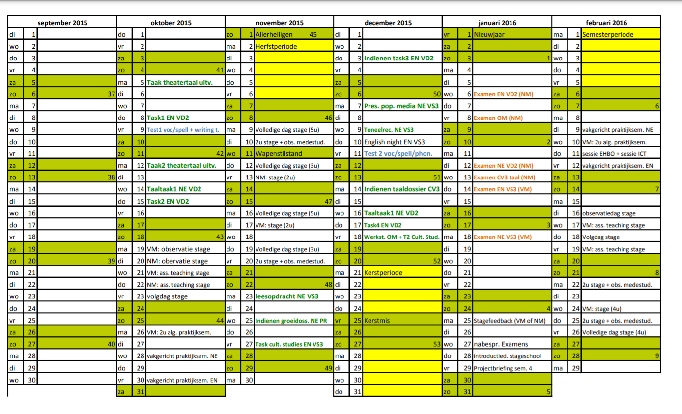
We are tackling procrastination: changing our BEHAVIOR
Study organisation – overseeing the semester as a whole
Home assignment : What time do I have?

Slide 39
We are tackling procrastination: changing our BEHAVIOR
Study organisation – overseeing the semester as a whole
Home assignment : What time do I have?
Weekends and days off
Deadlines of tasks and group work
Internship periods
Holiday periods
Official block period
Exam period
All the things you already know now that will take up available study time: e.g. weekend with friends or family, youth movement…

Slide 40
We are tackling procrastination: changing our BEHAVIOR
Study organisation – overseeing the semester as a whole
Provide a clear overview. Work with colours per category.
Make sure all NOT AVAILABLE TIME is on the semester statement.
Hang this overview out above your desk. Cross out e.g. each week.

Slide 41
Overview
We tackle procrastination:
changing behaviour
Pros and cons
Where does my time go?
Study approach
Study environment
Study method
Study organisation
External and internal distractors
Digital tools
Processing time registration
Semester oversight
Weekly schedule

Slide 42
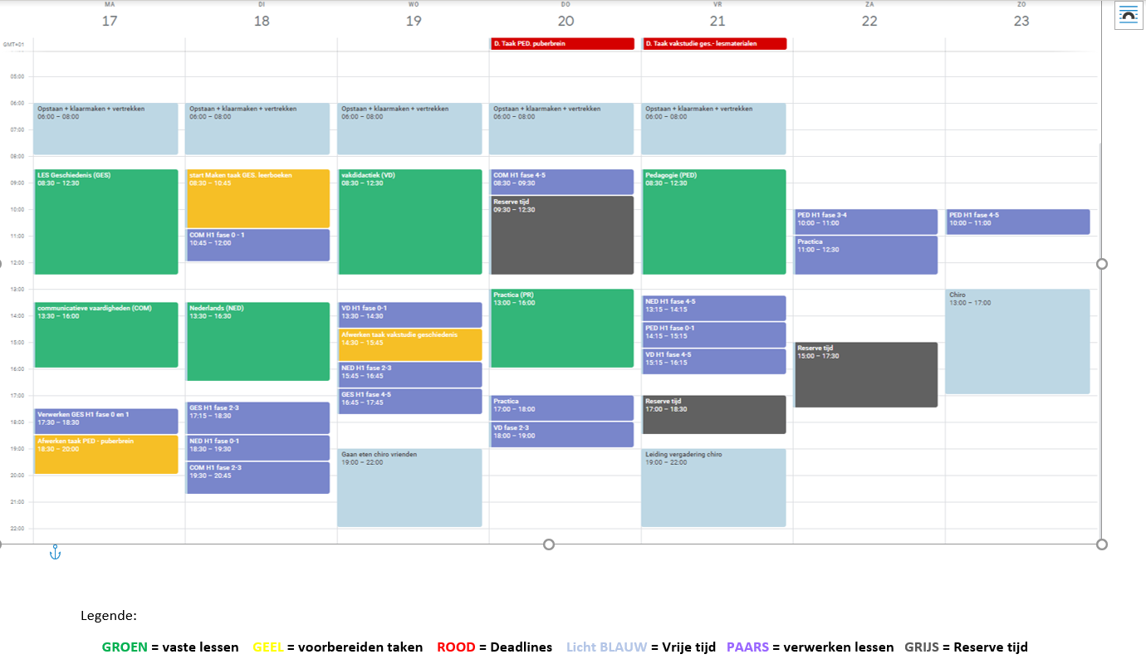
We are tackling procrastination: changing our BEHAVIOR
Study organisation – weekly schedule
Home assignment: Weekly planning
Via google agenda
Fill unavailable time
What space is left to study?
How much time do you want to
devote to your study? Build
this up.
4. Start from the to-do list.

Slide 43
We are tackling procrastination: changing our BEHAVIOR
Study organisation – weekly schedule
Home assignment: Weekly planning
4. Start from the TO-DO list.
Use the ‘repeat’ button for fixed weekly items.
Schedule a time every week to do your weekly planning.
Schedule weekly spare time.
Split large tasks into small subtasks, if necessary, and determine working time here too.
Be consistent with your colour categories.
Think about what you plan when.
Nice items = place last on the day
Turn your diary into a logbook.
Set automatic notifications.

Slide 44
We are tackling procrastination: changing our BEHAVIOR
Study organisation – weekly schedule
Home assignment: Weekly planning
4. Start from the TO-DO list.
Set up items SMART!
Not: I’m going to work for school
Well: history C1: ‘listing concepts in Time, Space and Context’ scheduled from 1pm to 4 pm.
You say what you will do (Specific)
You say how much you are going to do. = You know when you will finish. (Measurable)
You see that task as a job. If this is not the case, you will already not want to start it. (Acceptable)
To be carried out in the specified time. (Realistic)
A clear start and end time. (Time-bound)

Slide 45
We are tackling procrastination: changing our BEHAVIOR
Study organisation – weekly schedule
Home assignment: Weekly planning
5. Reality check
Ensure balance. Little relaxation can only be done for short periods.
Provide variety in your schedule
Tasks versus repeating lessons
Avoid putting similar boxes one after the other
Heavy teaching day on Tuesday → I always plan an easy task after that, but still do something.
I go out on Thursday → I do not plan a study block on Friday morning.
I often underestimate my time, planning an extra 30 minutes per item by default.
Something I look forward to, I plan at best possible time and reward myself afterwards.

Slide 46
We are tackling procrastination: changing our BEHAVIOR
Study organisation – make adjustments where necessary
Review what succeeded each night
Something didn’t work out? = plan in reserve time
Each evening, review your schedule for the following day
Determine your number of study hours for the coming week
Learn from your planning from the previous week
I see that I study more because it is black and white. I am therefore more motivated.
Unproductive time is gone, time with friends is not touched.
I am not super-efficient yet, but I keep on doing it.
The time off feels more like earned.
It does not always succeed yet but I play equal attention to what does succeed.
I noticed that I study best just after class, mobile phone is downstairs. Little things help tremendously.
I am achieving my goals and that is gratifying. I feel better in my skin.

Slide 47
We are tackling procrastination: changing our BEHAVIOR
Study organisation – don’t give up!

Slide 48
Overview
We tackle procrastination:
changing behaviour
Pros and cons
Where does my time go?
Study approach
Study environment
Study method
Study organisation
External and internal distractors
Digital tools
Processing time registration
Semester oversight
Weekly schedule
Make adjustments where necessary
Don’t give up

Slide 49
How does procrastination affect me?
‘
What is problematic procrastination?
How does procrastination affect me?
What can and cannot I tackle?
What works, what doesn’t?
We tackle procrastination!
Make timely adjustments
Importance of motivation Tackling the G’s
Process of change My competences
BEHAVIOUR
THOUGHTS
FEELINGS

Slide 50
We tackle procrastination: changing our THOUGHTS
The role of thoughts
Assignment: The role of my thoughts in my procrastination?
Event | Thought | Feeling | Behaviour
Being woken up at night by a noise. | My brother comes home. | Relief | You turn around and sleep on.
 | The cat knocked something over. | Annoyed | You get up to go look.
 | There is a burglar in the house. | Fear | You wake up your lover and/or call the police or you stiffen up and hardly dare to breathe and move.

Slide 51
We tackle procrastination: changing our THOUGHTS
Thinking patterns or habitual thoughts
Why is procrastination so difficult to tackle?
Largest part of our thinking happens unconsciously.
Majority of our thoughts are based on habits.
We don’t think about them → we just carry them out. E.g. cycling, eating, driving a car…
Once you make a mistake in a habit → difficult to unlearn
E.g. eating with mouth open
MUST: get insight into ‘wrong habit’ before we can tackle it.
E.g. You can know how to eat with your mouth closed but if you don’t know you are doing this, you can’t change it.
The key to really changing is understanding your wrong thinking patterns
= faulty habitual thoughts

Slide 52
Overview
We tackle procrastination:
Changing thoughts
Role of thoughts on procrastination
Thinking patterns
Helpful and non-helpful thoughts

Slide 53
We tackle procrastination: changing our THOUGHTS
Non-helpful thoughts | Helpful thoughts
Are not concrete; Do not help you achieve your goal; Not realistic; Sometimes form too negative glasses e.g. I won’t succeed; Sometimes form too optimistic glasses e.g. it will work out; Based on something you haven’t actually checked. | Are concrete; Help you to take action; Help you reach your goal step by step; Is not necessarily optimistic thinking but realistic thinking.
English suits me, half of that course I actually already know. | English is not my most difficult subject. It studies quite smoothly. I just check my course what I already know and what I still need to spend some time on.

Slide 54
We tackle procrastination: changing our THOUGHTS
Non-helpful thoughts = procrastination
Assignment: Which procrastination excuses suit you?

Slide 55
We tackle procrastination: changing our THOUGHTS
Procrastination excuse | Impact? | Solution?
I don’t have enough time today. I have no inspiration today. | Legitimising procrastination It seems like a sensible choice. It is an apology, but she explains no real reason. Frequent talk of starting problem | Think: Do I say this more often? Is it more likely because you don’t feel like it? What exactly am I looking forward to? Set a limited goal to get going. E.g. 10 minutes to check what specifically I need to do for that assignment.
I’m going to do that first and then start. Tomorrow I will really start. | Good intentions You recognise that you should do something (satisfied feeling), you don’t do it (dissatisfied), you will do it tomorrow (satisfied). The action itself is shifted each time. | Aks yourself the question: What fact tells me now that I will do it tomorrow then? Does that thought help me do it effectively? Look at past experiences and facts.

Slide 56
We pakken het uitstellen aan: ons GEDACHTEN veranderen
Procrastination excuse | Impact? | Solution?
I have plenty of time. I’ll catch up. Everyone defers and passes the exam. | Unrealistic optimism You appease yourself. → satisfied feeling It is not based on facts. Underestimating tasks. You overestimate your time and your own capabilities. | Develop a realistic vision: prove to yourself that your proposition is true by checking what you still have to do CONCREET. Don’t believe in fairy tales, don’t be naive: Your dorm mate does study Sometimes you need luck on your exam, most of the time you don’t! The student period is the best time of your life… So are there only 4 great years in your life?
I never succeed. There’s no point in starting, it’s already too late. | Unrealistic pessimism Inverse of above. Fear and doubt “I didn’t got everything out of it…” | Develop a realistic vision Focus on your task, not on what you think. E.g. I don’t know an answer immediately: focus on finding the answer instead of always thinking you can’t do it.

Slide 57
We pakken het uitstellen aan: ons GEDACHTEN veranderen
Procrastination excuse | Impact? | Solution?
That’s just the way I am. It has to come from myself anyway. I’m just a procrastinator. It used to word out that way. | Unchanging self-image The way you see yourself affects how you feel and behave. | Situations are changeable, people can adapt and change! = Based on evolutionary theory Adjust your self-image: you were not born this way, so can address your procrastination.
I don’t really believe in plans. The previous plan didn’t help me either. It should happen naturally, I’m smart enough. I can’t stick to a plan. | Discarding possible solutions Change takes effort. You don’t know if you will get results. Therefore, possible solutions are often ‘thrown away’. | Be critical of yourself when you consider a possible solution irrelevant to yourself. Everyone works with a plan: companies, bands, theatre. It means that that particular plan was bad, not all plans. Unfortunately, studying never comes naturally. You better ask yourself, “Why?”.

Slide 58
We pakken het uitstellen aan: ons GEDACHTEN veranderen
Procrastination excuse | Impact? | Solution?
Someone just knocked on the door. Breaks run out because I was on the phone. | Other | Saying no is unfortunately necessary and inevitable to achieve anything. TIP: “do not disturb” sign

Slide 59
We tackle procrastination: changing our THOUGHTS
Tackling procrastination excuses
To recap
Procrastination excuses = non-helpful thoughts
You follow them out of habit. → You keep going in circles.
Breaking habitual thoughts. → Realising when you are using a procrastination excuse
Bend the procrastination excuse into a helping thought.

Slide 60
We tackle procrastination: changing our THOUGHTS
Tackling procrastination excuses
How do I turn procrastination into a helping thought?
For each procrastination, ask a few questions:
Is what I am thinking correct? On what facts do I base myself?
Have I had previous experiences that show I can now believe this thought?
Is my intention vaque or super concrete and clear to me?
Does this thought help me achieve my goal?
Is this thought just helping me feel better or is there more to it?
How would I react if a friend had this thought in this situation? What would I say then?

Slide 61
We tackle procrastination: changing our THOUGHTS
Tackling procrastination excuses
How do I turn procrastination into a helping thought?
Procrastination excuse | Questions | Helping thought
I’m going to black out on my French exam. I might as well do something else now to calm myself down a bit. I’m not going to be able to study now. | Are you sure this will happen? Have you succeeded before? What helped then? Does this thought help you feel more confident? | It is not certain that I am going to black out. I have taken a French exam before where it went reasonably smoothly. A good example helps to make me feel confident. Starting with it is the hardest thing but once I get going, I useally see that it’s not too bad. I’m going to study 10 pages now and tomorrow I’ll do the rest.

Slide 62
We tackle procrastination: changing our THOUGHTS
Tackling procrastination excuses
To recap
How do I turn procrastination into a helping thought?
Home assignment: note the questions on a post-it and hang it in a central place
Procrastination excuse | Questions | Helping thought

Slide 63
Overview
We tackle procrastination:
Changing thoughts
Role of thoughts on procrastination
Thinking patters
Helpful and non-helpful thoughts
SMART also for action plan procrastination
Procrastination excuses
Tackling procrastination excuses

Slide 64
We tackle procrastination: changing our THOUGHTS
SMART also applies to plan to tackle procrastination
Action plan should not have too large or too vague statements of intent.
Make concrete what steps you are taking to tackle procrastination.
E.g. top athlete
Ahaaaa moments = postpone insights for formatting action plan | Action points | Action points SMART
Behaviour you can unlearn | If you can complete the task within two minutes, do it immediately. | If you can do the task, reply to email, within two minutes, do it immediately.
I’m one of those procrastinator types: passive fear of failure | Make list of my internal distractors and hang it on the wall. | When this session is done, I make a list of my internal distractors and hang it on the wall above my desk.

Slide 65
We tackle procrastination: changing our THOUGHTS
Focus
Degree to which we can focus attention on one thing.
What influences concentration?
Distractors on desk
Setting a clear goal
Goal is formulated SMART
Still struggling to concentrate?
Good thing you noticed!
Write down your thoughts on a sheet and refocus on your original goal
Be aware: our minds are fickle, attention is fleeting.
You can build your concentration skills!

Slide 66
We tackle procrastination: changing our THOUGHTS
Focus
Building concentration capacity
Compare with training puppy
Puppy is easily distracted and interested in everything, will not step along smoothly.
You do not anger the puppy, but bring puppy’s attention back to you and walking pace.
Reward when he walks nicely beside you.
You do this over and over again.
Notice when you are distracted.
Realise that you notice this.
Bring your attention back to the course.
Do this over and over again.
Focus on the number of times you bring your attention back to the course rather than the number of times you were distracted.
Reward yourself!

Slide 67
We tackle procrastination: changing our THOUGHTS
Focus
The Pomodoro method

Slide 68
Overview
We tackle procrastination:
Changing thoughts
Role of thoughts on procrastination
Focus
Thinking patterns
Helpful and non-helpful thoughts
SMART also for action plan procrastination
Procrastination excuses
Tackling procrastination excuses

Slide 69
How does procrastination affect me?
What is problematic procrastination?
How does procrastination affect me?
What can and cannot I tackle?
What works, what doesn’t?
We tackle procrastination!
Make timely adjustments
Importance of motivation Tackling the G’s
Process of change My competences
BEHAVIOUR
THOUGHTS
FEELINGS

Slide 70
We tackle procrastination: changing our FEELINGS
The role of feelings
What do the three types have in common?
‘Passive fear of failure’: Sofie's story (low confidence in ability, sitting for 30 min staring at 1 sheet, watching TV series because now it won’t work anyway)
‘The seeking student’: Steven's story (some subject interesting, some less interesting)
Optimistic procrastinator | Passive fear of failure | Seeking student
Sometimes worries, but often still experiences plenty of time. Chooses activity at time. Choise is determined by degree of importance. Delivers short-term good feeling. | Low confidence in own ability. Creates frustration, leading to a move to another city. Not dwelling on bad feelings for a while. | Doubts make it difficult for him/her to take action. E.g.: Is this the right study methodology? This is not a fun subject. Is the course right for me then? Avoids difficult questions, returns feeling calmer.

Slide 71
We tackle procrastination: changing our FEELINGS
The role of feelings
Procrastination rewards short-term = instant good feeling
The more you procrastinate → the more negative the feelings become in the long run
Doubt about own ability
Aversion to hard work
You feel guilty
…
You want to get rid of these feelings again also becomes more difficult
You don’t just procrastinate
You look for ways to numb these feelings
Hanging in front of the TV for hours, spending hours on social media, gaming endlessly, planning your social calender all over, indulging in nightlife, overeating …

Slide 72
We tackle procrastination: changing our FEELINGS
The role of feelings
Misconceptions affect your self-image:
So am I lazy after all?
Weighs emotionally
Awakens difficult thoughts and emotions
Pushes task away + unpleasant feelings and thoughts that reinforce each other away
Causes stress
Causes physical complaints

Slide 73
We tackle procrastination: changing our FEELINGS
Stress and physical complaints
Assignment: What are my alarm signals?
Tense feeling in the neck
A knot in the stomach
Tired
Headache
Lifeless
Cramped muscles
Sleep problems
Impatient
Pressure on chest
Difficulty concentrating
Other?

Slide 74
We tackle procrastination: changing our FEELINGS
How do I deal with these feelings?
Step 1: notice the stress – physical symptoms
Step 2: look for the underlying reason
Do I regularly have these physical complaints?
How do I feel? How do I look at myself?
Am I satisfied with my schoolwork?
Am I satisfied with how I approach my schoolwork?
Step 3: Take action
By performing actions, defined in: our behaviour, thoughts and belief in competences (see later)
By learning to cope with the stress – physical symptoms

Slide 75
We tackle procrastination: changing our FEELINGS
How do I deal with stress and the physical symptoms?
Spend time on relaxation exercises
Helps prevent and tackle stress and physical complaints
Physical complaints due to stress are caused by:
Excessive muscle tension
Brain not getting enough oxygen at that time
Perform abdominal breathing exercises
Forces you to breathe calmer and deeper
Easiest way to release tension and pump oxygen to your brain

Slide 76
We tackle procrastination: changing our FEELINGS
How do I deal with stress and the physical symptoms?
Perform abdominal breathing exercises

Slide 77
We tackle procrastination: changing our FEELINGS
How do I deal with stress and the physical symptoms?
Other exercises around:
Stress
Fear
Self-confidence
Peaking
….
On www.geluksdriehoek.be/oefenignen
Or on www.psywest.be + see workshops
Contact Psychosocial service of STUVO for individual interview.

Slide 78
Overview
We tackle procrastination:
Changing feelings
Role of feelings on procrastination
How do I deal with stress and physical complaints?
Stress and physical complaints
How do I deal with these feelings?

Slide 79
How does procrastination affect me?
‘
What is problematic procrastination?
How does procrastination affect me?
What can and cannot I tackle?
What works, what doesn’t?
We tackle procrastination!
Make timely adjustments
Importance of motivation Tackling the G’s
Process of change My competences
BEHAVIOUR
THOUGHTS
FEELINGS

Slide 80
We tackle procrastination: believe in my competences
What aspect sticks with you after listening to the video?
What is ‘talent’?
What are ‘competences’?
Why is believing in your own competences important?

Slide 81
We tackle procrastination: believe in my competences
ANYONE has the power to perform certain feats.
ANYONE is competent.
EVERYONE is unique and has several capacities.
What are you good at?
Home assignment:
What activity are you engaged in when time passes at lightning speed?
TalentenTinder van ODYN
Write this down on a post-it and hang it out in a central place.
Watch this when you have a difficult moment.
Having doubts about the match between your chosen course and your talents?
Make an appointment with you programme’s STUVO service.

Slide 82
How does procrastination affect me?
What is problematic procrastination?
How does procrastination affect me?
What can and cannot I tackle?
What works, what doesn’t?
We tackle procrastination!
Make timely adjustments

Slide 83
And the best tip last…

Slide 84
You got this!

