Slide 1
Workshop
Plan and organise

Slide 2
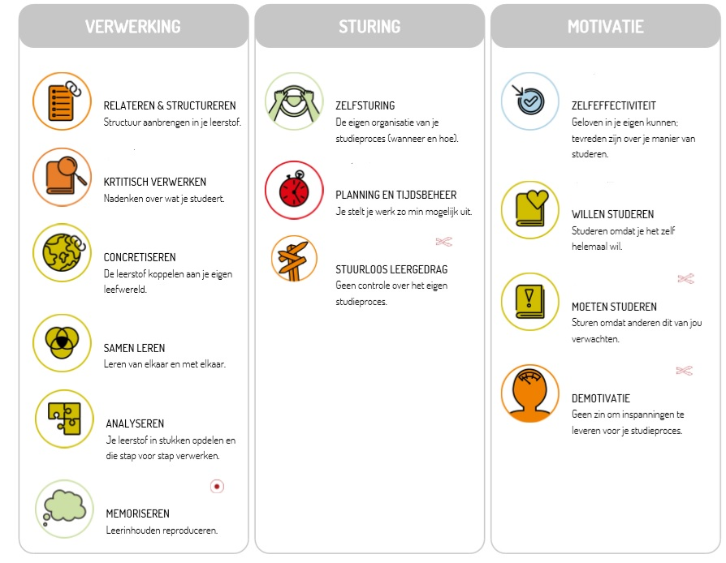
What Lemo skills are covered here?
PROSESSING
GUIDANCE
MOTIVATION
Self-direction
Planning and time management
Rudderless learning
Make a personal appointment with your study coach

Slide 3
Recognisable?
Full of enthusiasm, you start your day but throughout the day you lose track of what you were going to do…
You’ve been at it for half a day… you realise you can’t possibly finish everything you had in mind…
→ time for timemanagement!

Slide 4
WHAT TO EXPECT
Why plan?
How to plan?
Step 1: determine your time commitment
Step 2: get a view of your semester
Step 3: create a to-do list
Step 4: plan ahead!
Optimise your concentration
Pomodoro method
Schedule attitude

Slide 5
Why?
Planning = distributing tasks and activities over the time you have
Why?
No unpleasant surprises
Monitoring progress + increases likelihood of success
Overview/structure: grip on time and objectives
Quality time = deserved quality time

Slide 6
Step 1: determine your time commitment (1/3)
A. Timekeeping
Where does my time go?
Lots of overestimating and underestimating
Time there is;
The task you need to do or the course you need to study
Yourself and your capabilities (how quickly you think you can get something done).
Time tracking app: Toggl
Categories
Lesson/internship
Studies/assignments
Relaxation
Basis needs
Sleep
Student job
Travel
Unfocused
Cut-off time

Slide 7
Step 1: determine your time commitment (2/3)
Timekeeping
Where are you on the curve?
Hours
depletion
Average student
Too little study time
Weeks

Slide 8
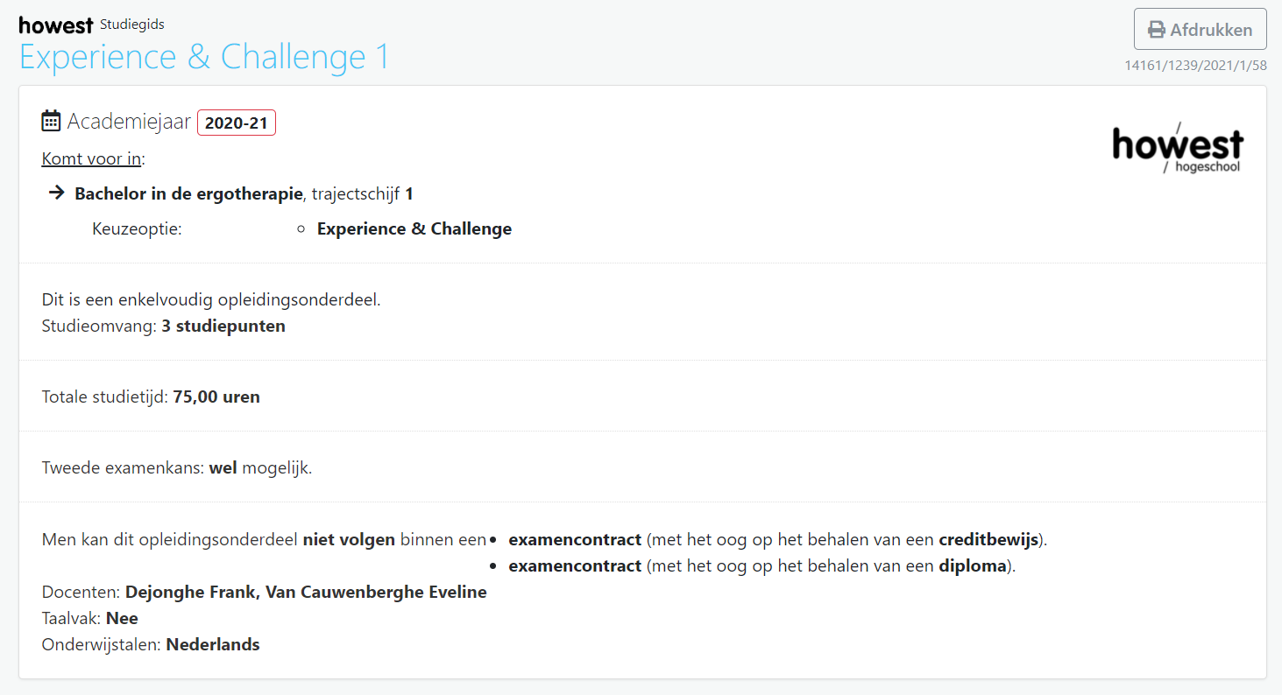
Step 1: determine your time commitment (3/3)
B. ECTS sheets as a guideline
1 SP = 25-30 hours of study activity (covers everything in the subject)
Work an average of 40-50 hours per week on school = full-time job
www.howest.be/ects

Slide 9
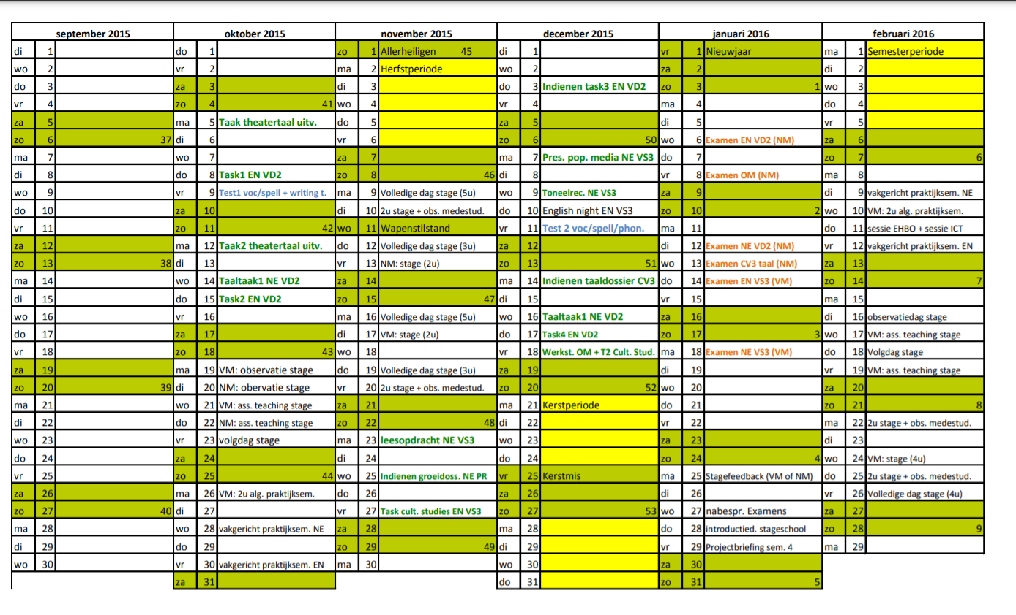
Step 2: get a view of your semester
Weekends and days off
Deadlines of tasks and group work
Internship periods
Holiday periods
Official block period
Exam period

Slide 10
Step 3: make a to-do list
List boxes
Per subject concretely:
Deadlines
TO DO | Deadline | Sub-tasks | Timing?
Task Interview game design | 8/04 | Interviewer search | 30’
 |  | Drafting questions | 2u
 |  | Conducting an interview | 1u30’
 |  | Make report | 3u
Reflection report | 25/04 | Make report | 3u

Slide 11
Step 4: planning ahead! – How (1/2)
Block all unavailable study time:
Lessons (automatic synchronisation)
Leisure + appointments: hobbies, weekends away, nights out, dentist visits…
Internship periods
2. Schedule tasks
Schedule deadlines (already done at semester overview → do when you get deadline)
Schedule work time of deadlines (see to-do list)
3. Schedule time to process learning
Formatting subtasks processing learning material
Maintain to-do list + evaluate

Slide 12
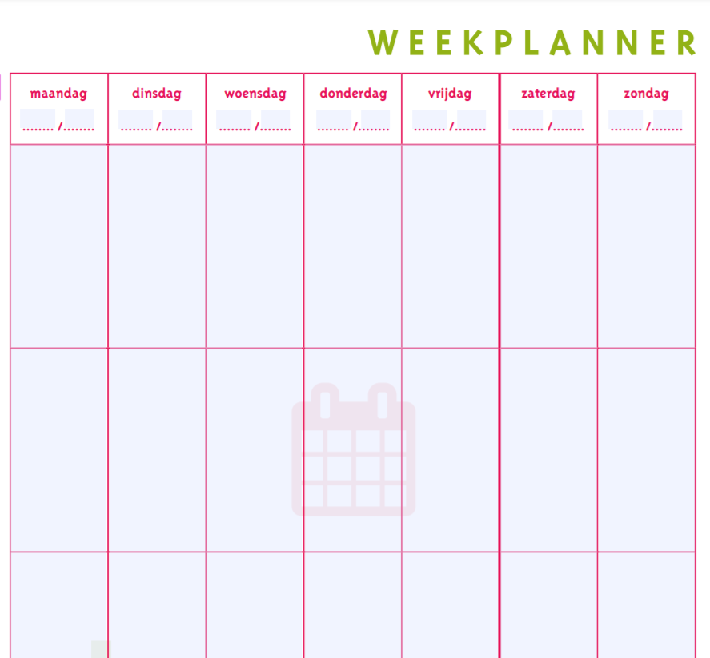
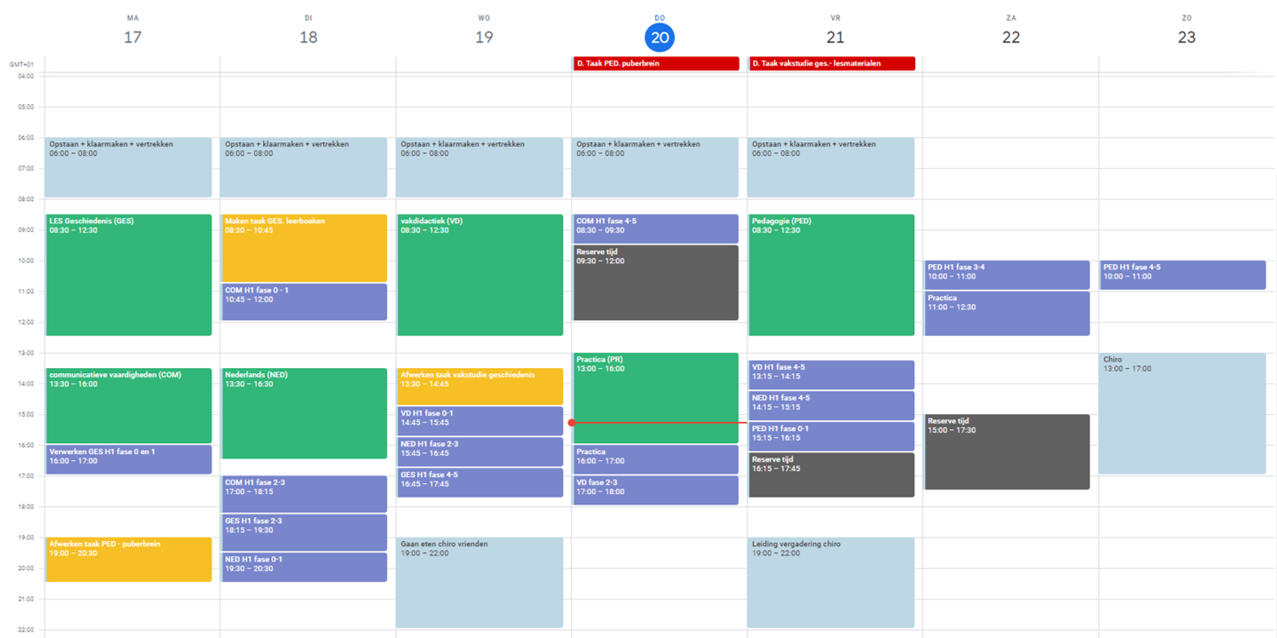
Step 4: planning ahead! – How (2/2)
Online diary of on paper
Hours
Study + free time + fixed appointments (colour)
Planning ≠ static = dynamic
Regular adjustments
Buffer moments
Concrete scheduling (SMART)

Slide 13
Step 4: plan ahead! – SMART (example)
Not: I will work for accounting basics
Well: ‘making accounting basics part 1 chapter 1 glossary’, scheduled from 1pm to 2.30pm.
SPECIFIC: You say what you are going to do
MEETABLE: You say how much you are going to do. = You know when you are done.
ACCEPTABLE: You see the task. If this is not the case, you will already not want to start it.
REALISTIC: To be carried out in the specified time.
TIME LIMITED: And clear start and end times.

Slide 14
Step 4: planning ahead! – Golden tips
Check for realistic planning
Provide reserve moments
Provide sufficient time per task
Do not plan everything full (i.f. respond to urgent/last-minute matters)
Provide a 1-day buffer before a deadline
Make a balanced schedule (relaxation versus working for school)
Provide variety
Turn your diary into a logbook
Consult every day – adjust where necessary
Formatting weekly schedule → automatic repetition
Be consistent with colours
Fun tasks? Schedule these at less obvious times

Slide 15
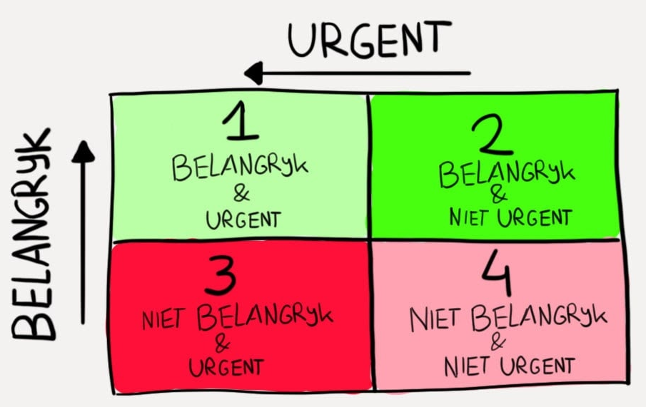
Step 4: plan ahead! – Setting priorities

Slide 16
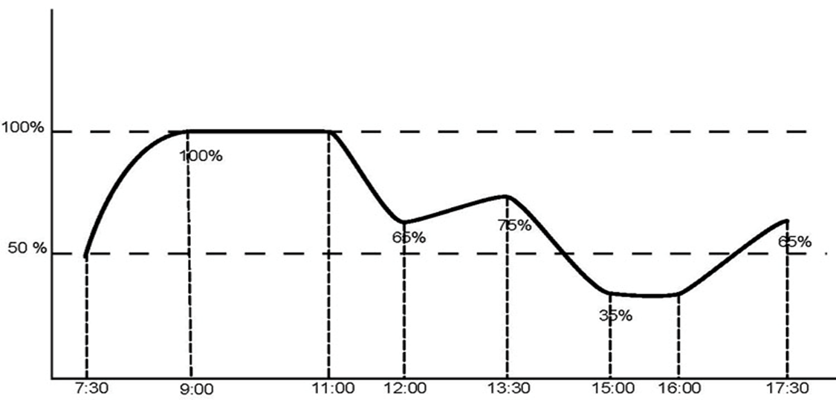
Step 4: plan ahead! - Productivity

Slide 17
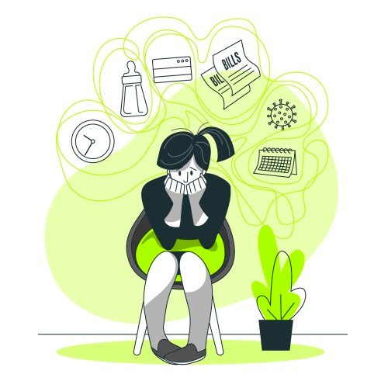
Optimise your concentration: distractors - triggers
Interne afleiders | Externe afleiders
Internal distractors
External distractors

Slide 18
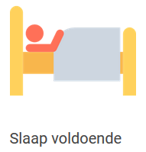
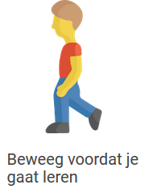
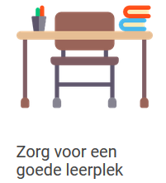
Optimise your concentration
Quiet and pleasant surroundings
Sufficient space
Few distractions
Digital capabilities
Get cold turkey
StayFocusd op de Chrome internetbrowser
FocalFilter voor alle internetbrowsers op Windows
SelfControl voor Mac
Eliminate background noise
Take regular breaks
Put your mobile phone away
Get enough sleep
Move before learning
Make sure you have a good place to study
Blocksite

Slide 19
Pomodoro-method

Slide 20
Plan attitudes
Avoid multitasking
Start on time
Keep big goal in mind rather than the feeling of the moment
Learn to say ‘no’: what is the worst thing that can happen when you say no?
Don’t get distracted by details: perfectionism makes projects drag on longer
Use the 80%-20% rule

Slide 22
Having trouble following your schedule?
Follow the workshop
‘problematic procrastination’
Follow #stuvohowest on TIKTOK or INSTAGRAM
for short studyhacks

