Slide 1
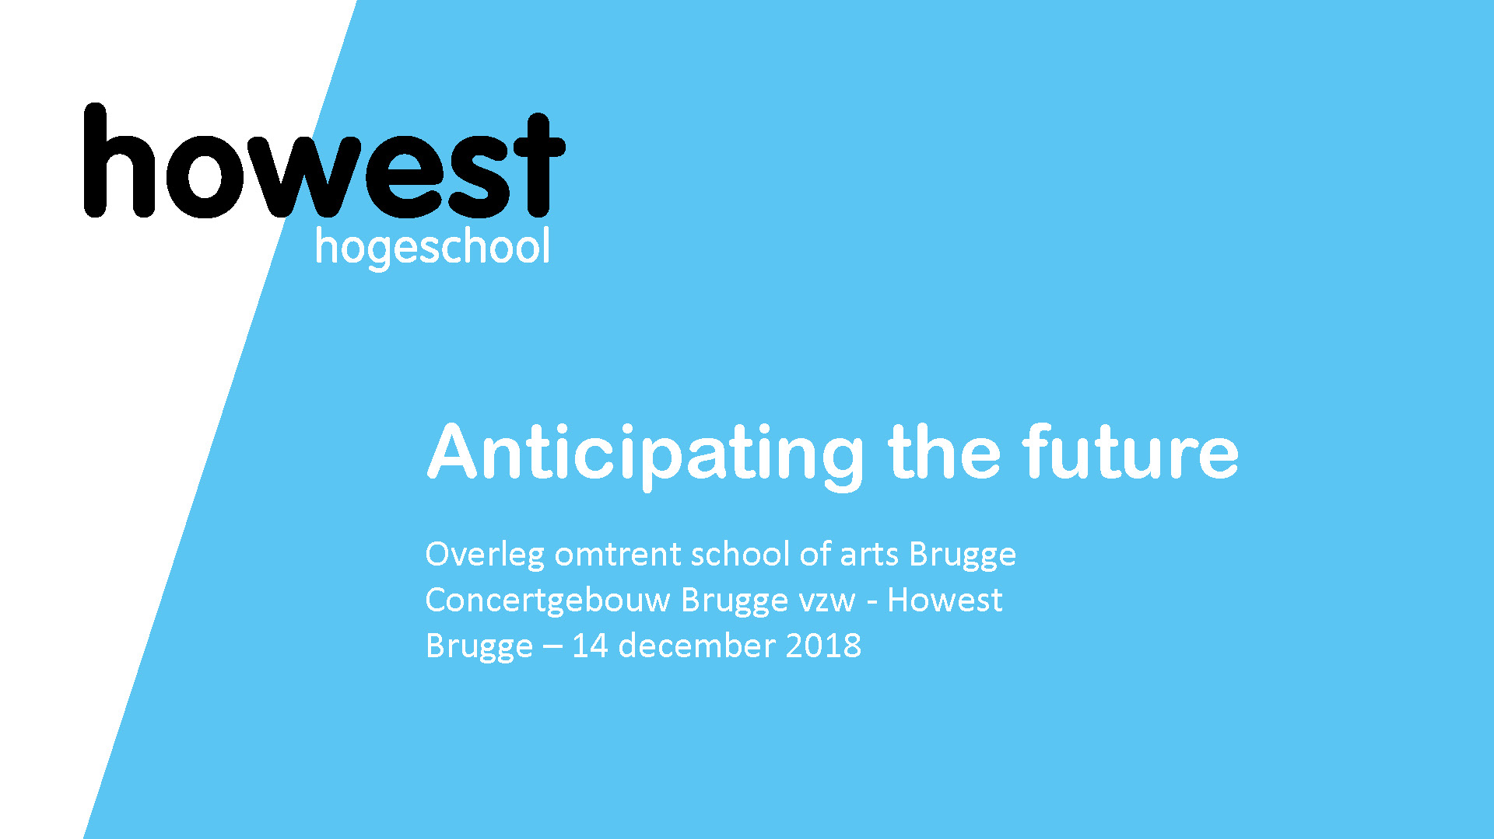
Reflect, FeedBack and FeedForward

Slide 2
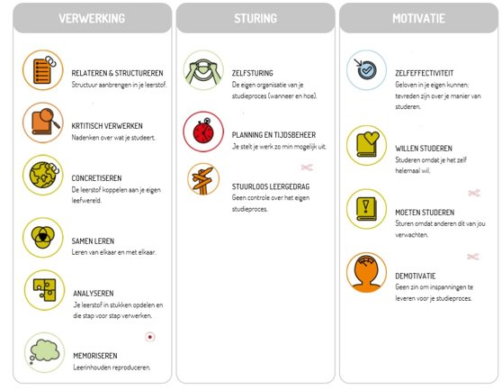
Visualisation Lemo test

Slide 3
What to expect
Howest’s vision around student support
1.1 Lifelong learning curriculum
1.2 Student counselling
The link to the Lemotest
2.1 My results
2.2 Setting up (SMART) goals
The concepts of reflection, feedback and feedforward
3.1 Reflect
3.2 Feedback and feedforward
4. Conclusion

Slide 4
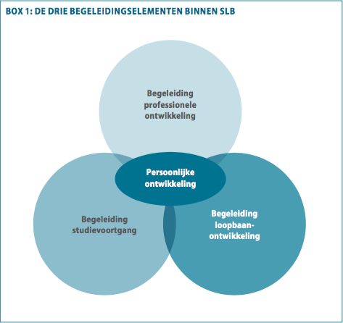
1. Vision
1.1 Lifelong learning curriculum
Professional development and career development:
focused on the content of the study, the curriculum.
Study progress: the preconditions/process to make training successful
Every course attaches importance to Lifelong Learning, the description is sometimes a bit different:
Portfolio
Learning line Professional Identity
…
And is mostly module-transcending
Reflect, feedback and feedforward

Slide 5
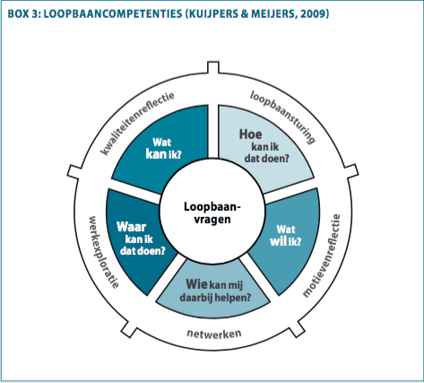
1. Vision
1.2 Student counselling:
Developing students into professionals in professional practice who know what they want and what they are good at
The reflections on experiences and the connection to personal goals
Awareness process into the professional they want to become
The student is supervised:
In making choices and developing competences:
Reflecting on own talents, motives, qualities and ambitions, career exploration, career steering and networking
On own acties, feedback on tasks, questions around norms and values

Slide 6
2. The link to the Lemotest
2.1 My results
After completing the Lemotest: your individual ‘feedback’ report
What do you do with this? How do you interpret my results?
Firstly:
I completed this test at my own discretion, the results are ‘reliable’ and directional?
Secondly:
I agree with my 3 strenghts, but I also take a look at the colours of my 3 strenghts, because the test automatically takes the 3 best results.
Can I further deepen my strenghts? And how do I do that? Do I best look at all the tips…

Slide 7
2. The link to the Lemotest
Thirdly:
I agree with my 3 working points, but even here I look at the colours for a moment there
Do I know how to work on this? Do I best read all the tips? Do I make an
appointment with the study coach
Just checking all the other learning skills

Slide 8
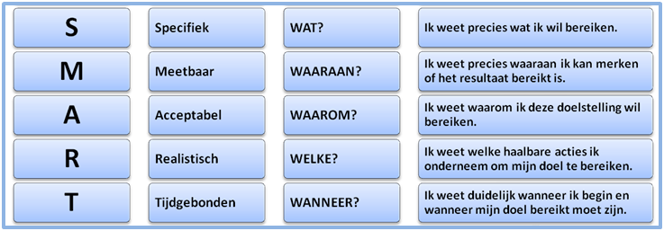
2. The link to the Lemotest
2.1 Setting up (SMART) goals
After further ‘analysis’ of my Lemo report, time to set correct goals:
Specifically​
Measurable​
Acceptable​
Realistic​
Time-bound
https://www.youtube.com/watch?v=1gd9hgejHm0
Specifically
WHAT?
I know exactly what I want to achieve.
Measurable
TO WHICH?
I know exactly by which I can tell if the result has been achieved.
Acceptable
WHY?
I know why I want to achieve this objective.
Realistic
WHICH?
I know what feasible actions I take to achieve my goal.
Time-bound
WHEN?
I know clearly when I start and when my goal should be achieved.

Slide 9
3. The concepts: reflect, feedback and feedforward
3.1 Reflect
To reflect is to think on a given fact (action, thought, feeling) with a view to learning something from it for improvement in the near and distant future
How else would I do it?
Reflection is conscious thinking.
When you reflect, you consciously think about something, pay extra attention to it. You reflect on an experience or your actions and ask yourself why you are doing it this way.
Reflection on a previous planning, previously attended workshops,
assignment I got back

Slide 10
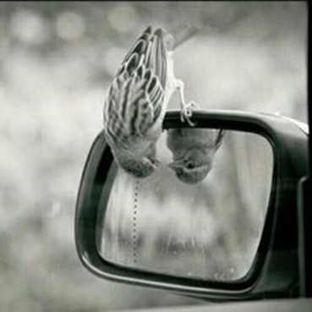
3. The concepts: reflect, feedback and feedforward
3.1 Reflect
Reflecting can be taught…
Reflection is a process of awareness
Taking the time for it, after the experience
Reflecting consciously on your actions is distancing yourself from
your own role
Looking at your own actions as objectively as possible

Slide 11
3. The concepts: reflect, feedback and feedforward
3.1 Reflect
Own experiences: when you reflect you start from your own experiences, find out what your actions triggered in others
Conscious: about different aspects of your actions, thinking about the why and how of your actions
Input from others: gaining insight into these different aspects through others, the input of others helps and is very important
Bring about change: aim to evaluate actions and seek alternatives, based on your own experiences and knowledge take a step forward

Slide 12
3. The concepts: reflect, feedback and feedforward
Recognise:
As a learner becoming aware of what happens and how it happens.
Recognising patterns, seeing through the characteristics of an event.
Recognition often happens out of dissatisfaction or frustration.
Acknowledge:
Seeing your own part through which patterns come about.
Taking responsibility for his of her patterns.
Explore:
Experimenting with other possibilities.
Trying out new behavioural options and strategies.
Integrate:
Applying what has been learned now in other (day-to-day) situations.
Profound change or growth occurs.

Slide 13
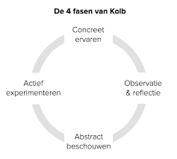
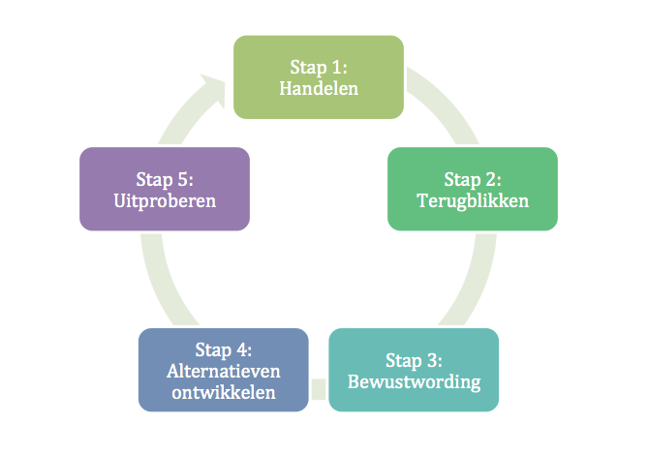
3. The concepts: reflect, feedback and feedforward
3.1 Reflect
As part of Kolb’s learning cycle (4 phases)
In multiple training also known as Korthagen (5 phases)
Kolb’s 4 phases
Concrete
experience
Step 1:
Acting
Step 5:
Try it out
Step 2:
Looking back
Active
experimentation
Observation
& reflection
Step 4:
Developing alternatives
Step 3:
Awareness
Abstract
contem-plation

Slide 14
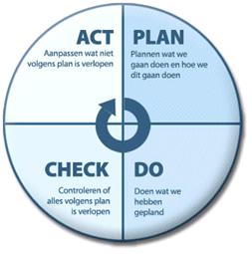
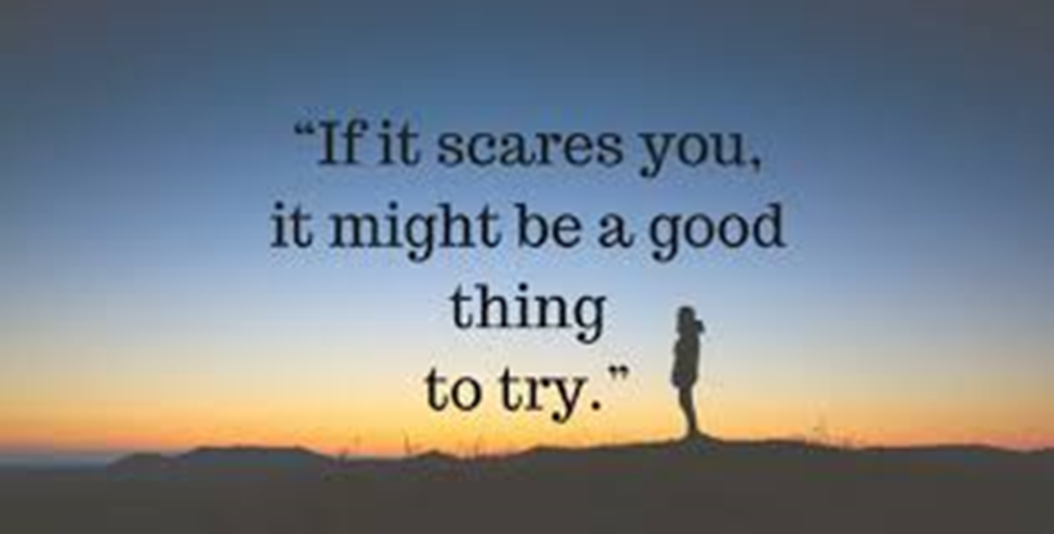
3. The concepts: reflect, feedback and feedforward
3.1 Reflect
The PDCA cycle is also often used in training courses
Is a good ‘tool’ in (self)reflection, equally in planning
Interlude: https://www.youtube.com/watch?v=_qIa5oSgBWU “do you dare to dream”

Slide 15
3. The concepts: reflect, feedback and feedforward
3.2 Feedback (and feedforward)
Gives me information on how my message is received and interpreted
How?
Communicate directly (immediately): the other has no message if you return to an incident from a week/a month/a … ago,
I-messages: do not address them from ‘men’/’we’, it is you who gives feedback
Verbalising thoughts and feelings: you tell the other person what your personal thoughts and feelings are about the action/behaviour the other person suggested
On the behaviour not on the person: the other is not an annoying person, but I find the behaviour you stated just now in the preparation for the group work very annoying, it bothered me and I thought of stopping further work.

Slide 16
3. The concepts: reflect, feedback and feedforward
3.2 Feedback (and feedforward)
Verbal FB vs non-verbal FB: both are attuned to each other, saying that you think someone else’s work is particularly clever and meanwhile turning your eyes is not right.
For your information: be careful with non-verbal
communication in emails
There is also Feed-Forward: this means that before your actions are explained a bit before you shoot into action, you can indicate to your (internship) mentor that you will soon start working that way, taking into account the feedback after last converstation.

Slide 17
3. The concepts: reflect, feedback and feedforward
3.2 Feedback (and feedforward)
Conditions:
The atmosphere and level of trust
Realising that FB is an important tool
Willingness to learn from each other
Positive effect because:
Recognition of positive behaviour
Corrects behaviour that is not constructive
Clarifies relationships

Slide 18
3. The concepts: reflect, feedback and feedforward
3.2 Feedback (and feedforward)
Rules:
Descriptive (not evaluative, jugdmental, interpretive)
Specific
Taking into account needs and requirements
Usable, must be desired, at the right time, clear and precise
Describe the effect of your statement

Slide 19
3. The concepts: reflect, feedback and feedforward
3.2 Feedback (and feedforward)
Hazards:
More or different awareness, may be experienced painfully
Feedback demanding change
Blind spots becoming obvious can cause uncertainty and upset
Desirable to estimate consequences in advance

Slide 20
3. The concepts: reflect, feedback and feedforward
3.2 Feedback (and feedforward)
Application:
During assignments at modules: feedback on assignment, possibly evaluation criteria
During monitorate: to the lecturer, substantive questions, ambiguities concerning a module
During mentoring: ask for and receive feedback in an open conversation about preconditions (so not linked to a module), e.g. about learning skills (see Lemotest)
After the exams: during the organised feedback moment, which at that time is more than just looking at the exam.

Slide 21
3. The concepts: reflect, feedback and feedforward
3.2 Feedback (and feedforward)
Application:
Note the feedback you receive
Show the other that you take the feedback into account by giving feedforward
Ask further when feedback is not clear
If the feedback is properly given, it is about your behaviour/actions, NOT about who you are as a person
Be careful with the word BUT:
If a positive message is given first, followed by BUT, there is a chance you will forget the positive message
If you want to explain your behaviour and you use BUT, this is often interpreted as defensive

Slide 22
4. Conclusion
Working with metaphor: using imagery
You describe, discuss from an animal/person/object the positive and lesser qualities of this animal/person/object and link these to youself…
I’m like a bear: I am very strong, to hug, but people are also afraid of me, …
I’m like a rock…
I’m like superman…
And this as part of self-reflection…

