Slide 1
Info session Learn to process

Slide 2
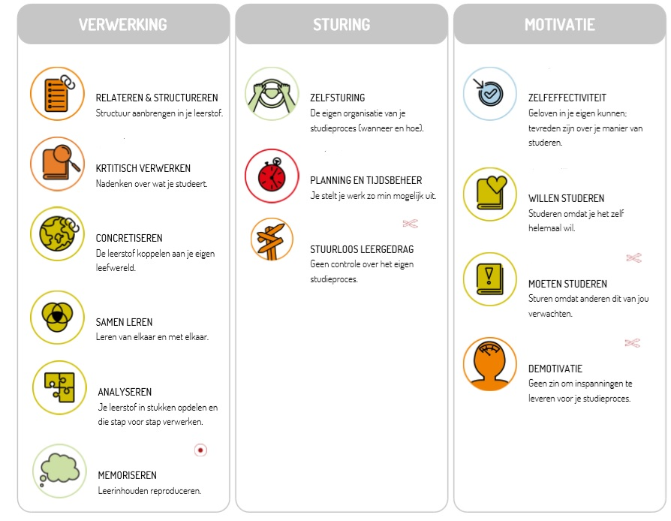
Which Lemo skills are covered here?
PROCESSING
STEERING
MOTIVATION
Relate & structure
Self-directed
Critical processing
Concretise
Steering learning behaviour
Make a personal appointment with your study coach
Learn together
Analysing
Memorise
Notes:
Uitleg lemo test: afgenomen → mailtje goleweb. → rapport geeft inzicht op je vaardigheden rond leerstof verwerken, sturing en hoe het met je motivatie gesteld is.
Deze factoren zijn van belang om te slagen voor je richting. Mocht je niet zo’n test afgelegd hebben en heb je toch interesse, stuur een mailtje naar uw talentcoach ( zie website)
Scoor je minder of is er nog groeimarge bij … dan speelt deze workshop hier op in
Link andere workshops
Link motivatie
Indien test niet afgelegd? Stuur gerust mailtje naar de studiecoach gelinkt aan jouw opleiding (zie website)

Slide 3
Steps in processing learning
Preparation time
Processing time
Study time
Orientation before the lesson
Note-taking during the lesson
Idea structure
Idea content
Content in detail
Visualisation processed content
Memorise
Repeat & check
Schedule
Personalised table of contents
Zie workshop notities nemen in de les
See workshop note-taking in class
See study workshop
Zie workshop studeren

Slide 4
Is making a summary still realistic in HE?
Yes, if enough time → usually not the case
clearly structured for learning material ( = goal of processing material)
Slops up a lot of time
Losing out in ‘overwriting’
Often no thorough processing of learning material
Rather: a structured coherent whole per module → easy studying

Slide 5
Processing learning material step by step
Choose 1 main source and add info:
E.g. course where you incorporate your notes and handbook
E.g. PPT where you incorporate the other sources
NOTE: Make sure you choose the main source where you have the least info to add.
Differs from module to module
Proceed step by step:
Look at the structure of course or textbook first, only then start reading the tekst = IDEA STRUCTURE
Then review the course by chapter = IDEA CONTENT
Read again and underline in the course = INCLUDE IN DETAIL
Make a visualisation of your learning = VISUALISATION REQUIRED CONTENT

Slide 6
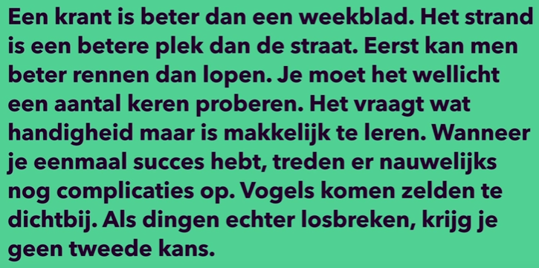
Idea structure – titles (1/4)
Look at the structure of course or textbook first, only then start reading the tekst
= IDEA STRUCTURE
The usefulness of titles? Just testing:
Making and launching a kite
A newspaper is better than a magazine. The beach is a better place than the street. At first, it is better to run than walk. You may have to try it a few times. It takes some dexterity but is easy to learn. Once you are successful, complications hardly ever occur. Birds rarely get too close. However, if things break loose, you won’t get a second chance.

Slide 7
Idea structure – table of contents (2/4)
Helicopter Vision
View the table of contents = IDEA STRUCTURE

Slide 8
Idea structure – introduction, conclusion (3/4)
Read introduction and conclusion first and only then the full tekst = IDEA STRUCTURE
Example of an introduction Example of a conclusion

Slide 9
Idea structure – objectives (4/4)
View objectives = IDEA STRUCTURE
KNOW
CAN
I explain the origins of strength-based work.
I can detect the principles of strength-based working
in a case.
I know the different life domeins from the strenghts model and can explain them using an example.
I can recognise the different life domeins in and apply them to a specific case.
I can explain and connect the strengths model and its different components.
I can recognise and connect the different parts of the strengths model, using a case.
I know how I can use the power model as a remedial educational supervisor during my counselling.
I can use the strengths model to name a client’s counselling needs.

Slide 10
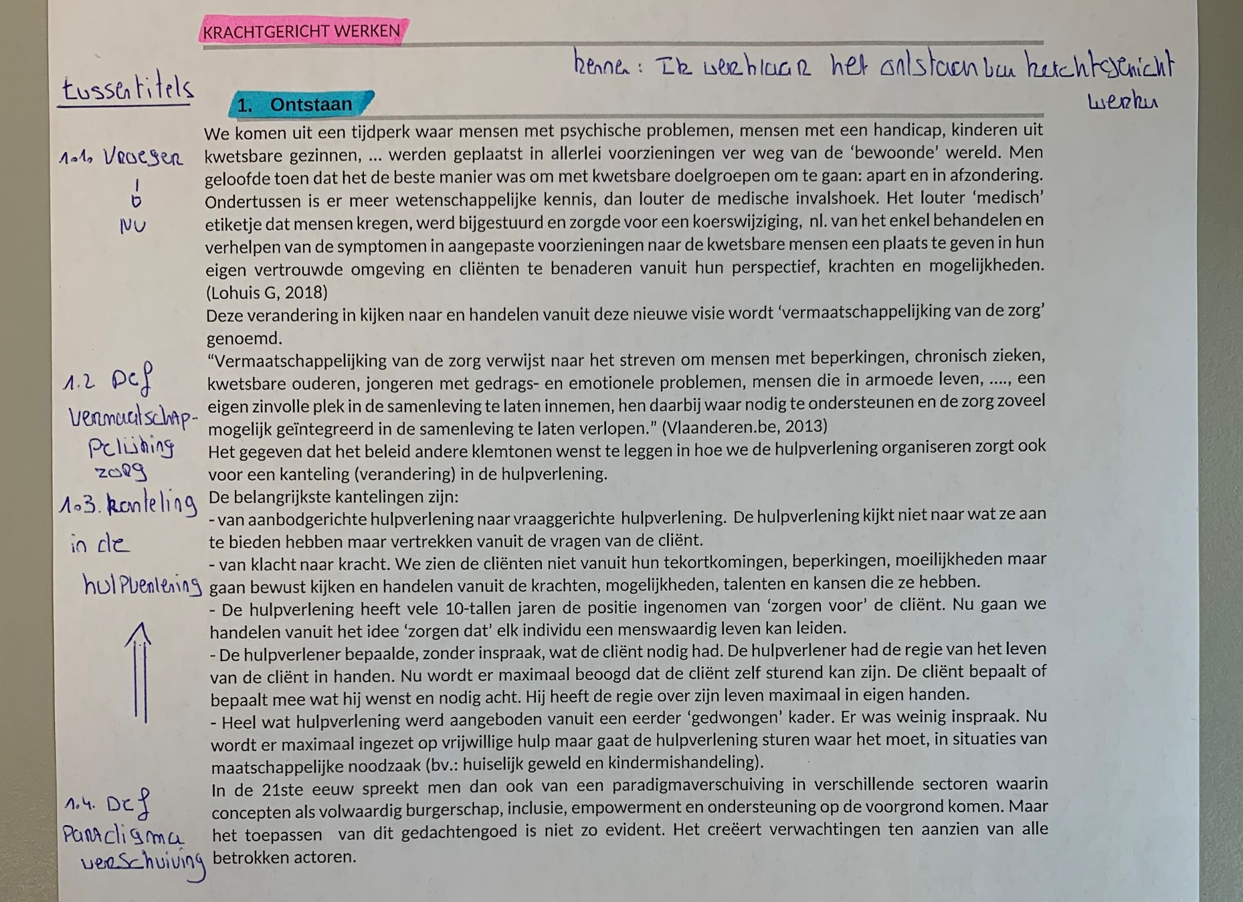
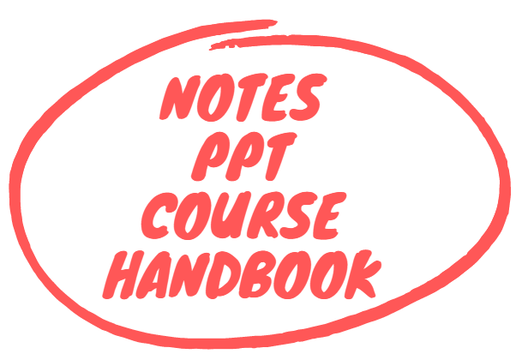
Idea content
Then review the course by chapter = IDEA CONTENT (helicopter view!)
Main idea per paragraph
What is the paragraph about?
Notes:
Je leest eerst de volledige alinea en je stelt je de vraag ‘waarover gaat dit?’ + voorkennis activeren → ga duidelijk na dat: wat je leest, ook begrijpt! Ga niet verder zonder dat je weet waarover het exact gaat (link met leesbegrip)
Nog niks aanduiden, wel kernwoord per alinea noteren

Slide 11
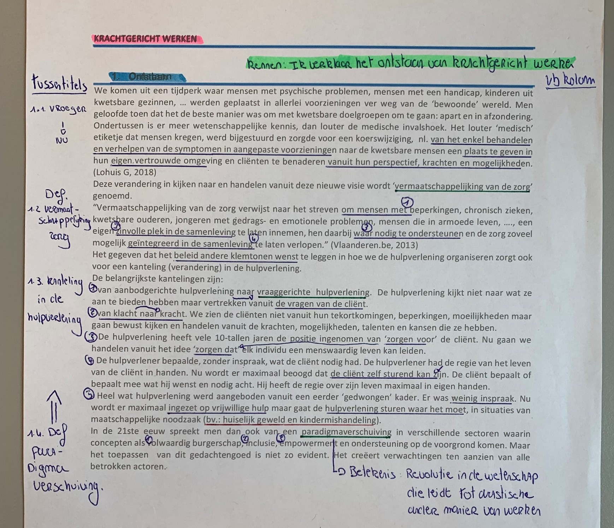
Processing content in detail
Read again and underline in the course = INCLUDE IN DETAIL
Key words (including specialist
terminology)
Signal words = making connections
Examples
Numbering
Synonyms
Do I understand everything?
(5W and H questions)
Notes:
Wat nodig om hoofdgedachte uit te kunnen leggen? Pas daarnà duidt je in de tekst aan, eventueel noteer je rechts een voorbeeld om het te verduidelijken.
Voordeel: je wordt sterker in verbanden leggen
Noteer synoniemen zodat je alle woordenschat begrijpt
Wie, wat ,waar, wanneer, waarom en hoe (hoofdgedachte per alinea)
Probeer een visuele beeldvorming te maken: kan ik bv. linken, hoe ziet dit er uit in de praktijk…
Herken signaalwoorden → lijstje maken en linken aan teksten dat je aan het lezen bent.
Verwerk info gestructureerd in de hoofdbron door:
Aandacht te hebben voor titels (kapstok voor leerstof)
Gebruik vaste kleurencodes voor bepaalde items bv. type titels, te kennen begrippen
Onderlijn de hoofdzaak en omcirkel eventuele woorden die je nodig hebt om de hoofdzaak uit te leggen
Noteer in de kantlijn het onderwerp van de alinea (helpt om hoofd- en bijzaken te onderscheiden)
Gebruik nummers bij opsommingen of kenmerken die een item omschrijven
Gebruik pijlen om verbanden te maken
Ga op zoek naar voorbeelden en noteer in de rechterkantlijn
Te veel info om in hoofdbron te verwerken? Maak een schema en verwijs hiernaar

Slide 12
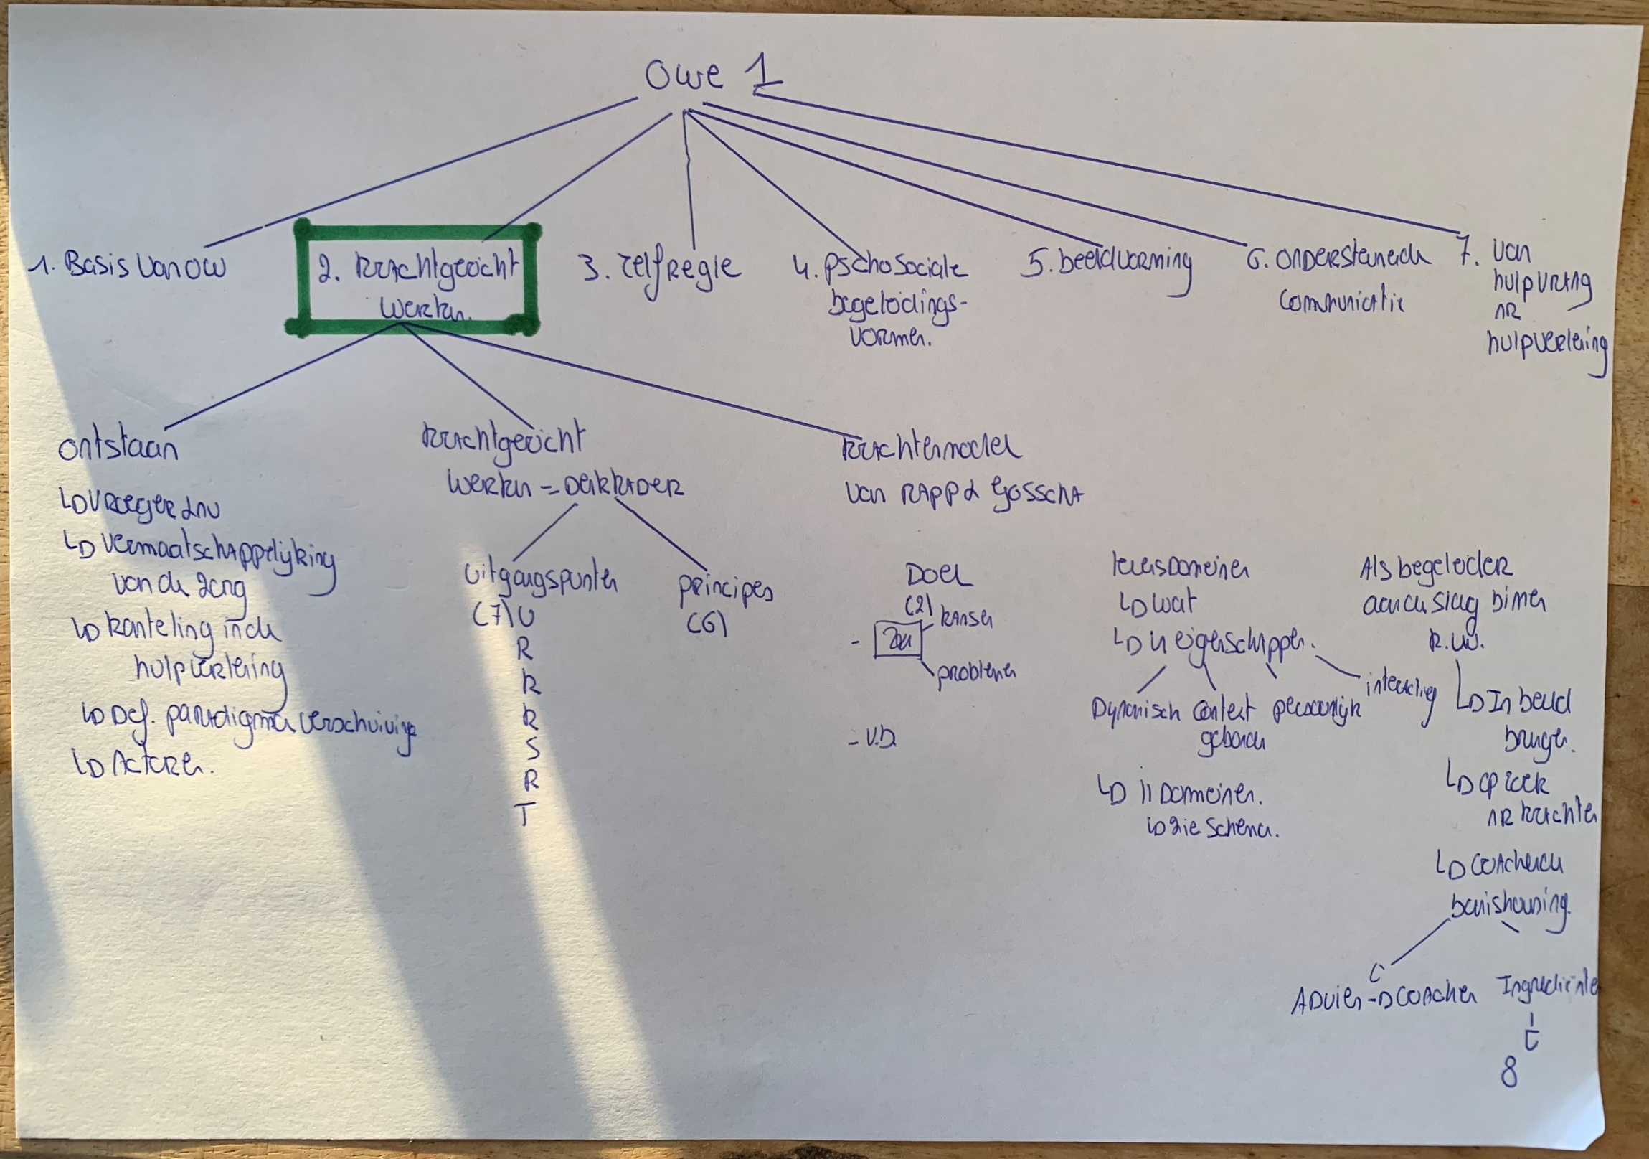
Visualisation processed content (1/4)
Make a visualisation of your learning = VISUALISATION REQUIRED CONTENT
Notes:
Anders verlies je eerst in details. Bekijk eerst de items die opgesomd zijn
Voordeel: je bent sterker in verbanden leggen
Zorg steeds voor helikoptervisie , weten waarover het gaat

Slide 13
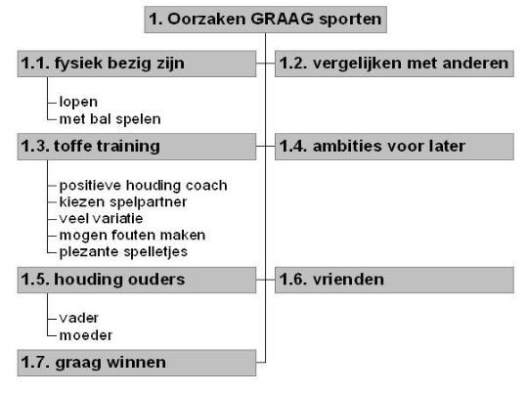
Visualisation processed content (2/4)
Make a visualisation of your learning = VISUALISATION REQUIRED CONTENT

Slide 14
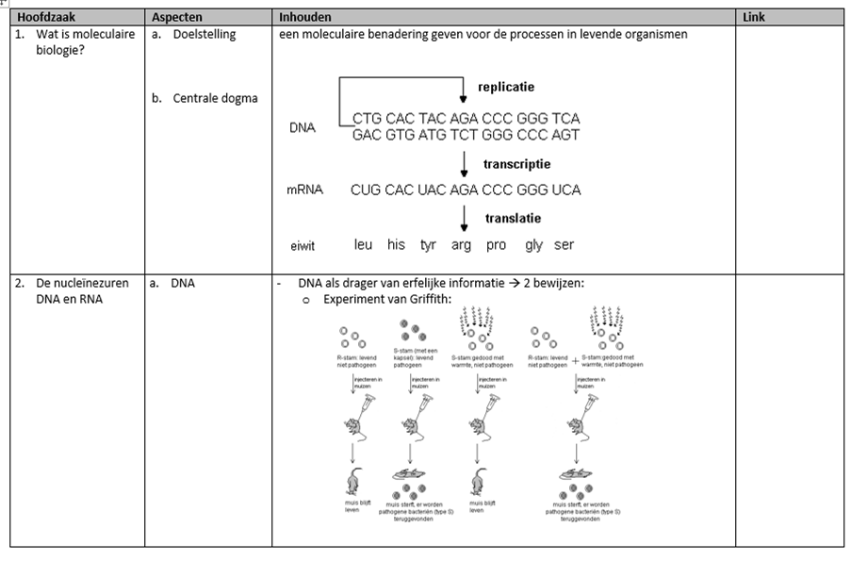
Visualisation processed content (3/4)
Make a visualisation of your learning = VISUALISATION REQUIRED CONTENT

Slide 15
Visualisation processed content (4/4)
Make a visualisation of your learning = VISUALISATION REQUIRED CONTENT

Slide 16
Exercise: read carefully and diagram (1/2)
First man on the moon
Neil Alden Armstrong was born on 5 August 1930. Ever since he was little, he had a keen interest in all things flying. So it surprised no one that he became a pilot in the US Navy in 1950. Twelve years later, in 1962, he became an astronaut. In March 1966, he was put in charge of the Gemini 8 mission, which unfortunately was aborted early due to fuel problems. The goal of Gemini project was to link spacecraft in space. Later, Armstrong was added to the Apollo project which aimed to take humans to the moon. In July 1969, he was put in charge of the Apollo 11 mission to bring the first human to the moon. Together with Edwin Aldrin and Michael Collins, he flew into space on 16 July 1969 and five days later became the first human to set foot on the moon. As he descended the stairs of the lunar lander, he spoke the historic words: ‘That’s one small step for man, one giant leap for mankind’.

Slide 17
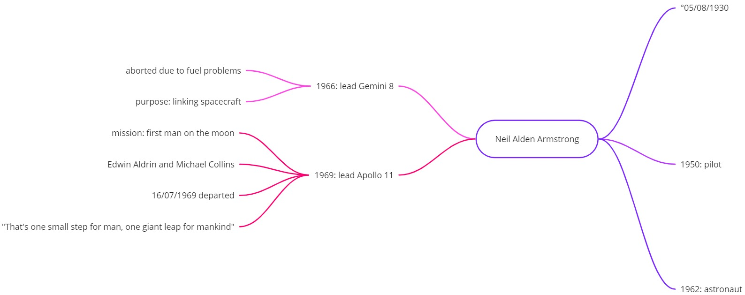
Exercise: read carefully and diagram (2/2)

Slide 18
Summing up: processing learning
Notes:
https://www.youtube.com/watch?v=aD1GqO2vwpI&t=1s

Slide 19
Step-by-step plan for processing material: summary (1/2)
Look at the structure of course or textbook first only then start reading the tekst = IDEA STRUCTURE
Table of contents
Objectives
View introduction and conclusion
Then review the course by chapter = IDEA CONTENT
Read paragraph by paragraph (do not underline yet)
Check what the paragraph is about and note 1 key word in the margin if necessary
Read again and underline in the course = INCLUDE IN DETAIL
Write down synonyms so you understand all the vocabulary
Who, what, where, why and how (main idea per paragraph)
Try to create a visual image: e.g. can I link, what does this look like in practice…
Make a visualisation of your learning = VISUALISATION REQUIRED CONTENT

Slide 20
Step-by-step plan for processing material: summary (2/2)

Slide 21
Want to learn more?
Website Howest: https://www.howest.be/nl/stuvo/studiecoaching
Digital workshops on learning platform LEHO with course ‘STUVO Study Coaching’
Follow @stuvohowest on Instagram and TikTok
LEMO test and feedback report
Contact the study coach linked to your course
https://www.howest.be/nl/stuvo/studiecoaching

