Slide 1
Active listening and note taking

Slide 2
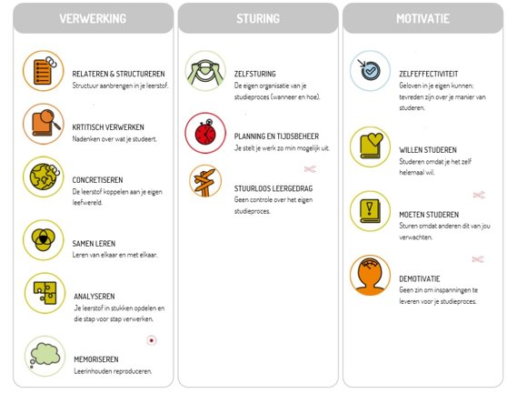
What Lemo skills are covered here?
Processing
Guidance
Motivation
Relate and structure
Self-direction
Rudderless learning
Make a personal appointment with your talent coach
Learn together
Analyse

Slide 3
Roadmap
Preparation time
Study time
Orientation for the lesson
Taking notes during class
Notes clearance & structure
Active reading comprehension and working your learning into a whole
Create a personalised table of contents and distinguish main and side issues
Memorise
Repeat and check

Slide 4
What to expect?
Listening is an ACTIVE and INTENSIVE process
1.1 Some statements: recognisable or not?
1.2 Maintain a positive and active study attitude
2. Targeting
2.1 BEFORE the lesson
2.2 DURING the lesson
2.3 AFTER the lesson
3. Conclusion

Slide 5
1. Listening is an ACTIVE and INTENSIVE process

Slide 6
1.1 Who recognises themselves in the following statements?
During the lesson, I only listen to the teacher and do not write anything down
I print the PowerPoint just before exams and get stressed because I can’t find everything again
I don’t find it necessary to take all classes
I note verbatim what the lecturer says
I am busy with assignments and tasks day in and day out and do not have time to look at the next day’s lessons
I try to take note of everything as well as I can but at a certain point I can’t keep up anymore
I review my notes a few weeks before exams

Slide 7
1.2 Maintain an active and positive study attitude
Finally goes to
college on Monday…
… to scroll for 3 hours
on Facebook

Slide 8
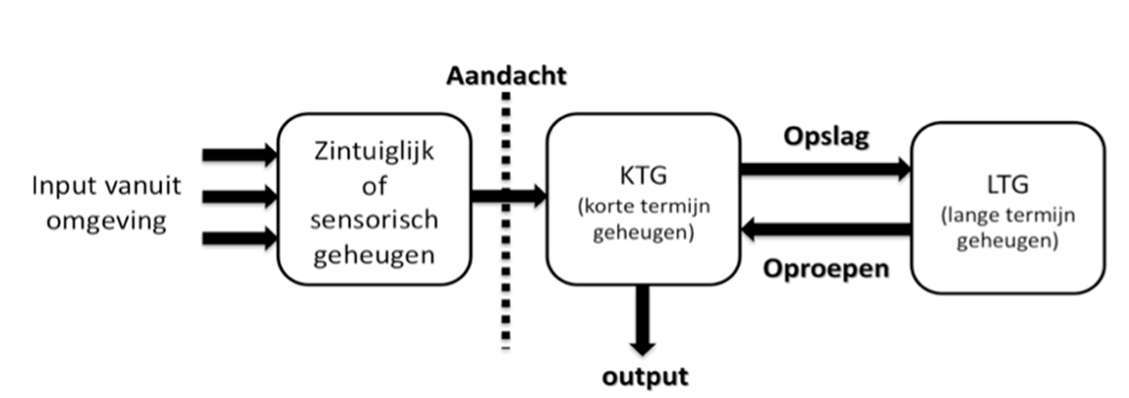
1.2 Maintain an active and positive study attitude
Complex and goes extremely fast
Taking lessons: it looks like the teacher is working but… YOU play an active role because notes are study material that YOU have to process
Purpose of noting:
Making a first selection between main and subsidiary issues
Then form the basis for transferring the info Short Term Memory (STM) to your Long Term Memory (LTM)
Working purposefully form the start to have processed your learning in a timely and thorough manner

Slide 9
1.2 Maintain an active and positive study attitude
One of the reasons to go to class
Appeal on STM -> 80% lost after few hours
Not mandatory, but note ongoing evaluation
Processing learning on your own is quite difficult
Check for each module
Objectives (ECTS sheets)
GATHER your study materials -> create an overview
What does the evaluation look like
Take out your PPT and consider what you need to listen with concentration

Slide 10
1.2 Maintain an active and positive study attitude

Slide 11
2. Targeting
2.1 BEFORE the lesson
COMPARE your teaching materials
What will the curriculum be about?
What is this chapter about?
Watch the PPT for the next lesson and scan quickly
-> 5 to 10’ per lesson (!)
-> during your less productive moments
(see digital workshop on Planning and organising)
Table of contents
Titles
PPT
Quick and selective

Slide 12
2. Targeting
2.1 BEFORE the lesson
Why:
Havind an idea of what will be covered in next lesson
Retrieve prior knowledge, activate
Familiarise yourself with technical jargon
Result:
-> Time to listen more attentively
-> Determines what to note and what not to note

Slide 13
2. Targeting
2.2 DURING the lesson
What:
Active listening
Taking good notes
Depending on preparation
Abbreviations (pay attention in assignments and tasks!)
Symbols
White spaces
Highlight uncertainties
Own words
Keywords
Symbols
Pointers lector

Slide 14
2. Targeting
How:
Attention to structure/construction:
Where is the subject matter located, what do we see today, …
Key pointers from lecturer
Linking words (follows, important, concrete e.g., …)
Linguistic elements
Personal style

Slide 15
2. Targeting
Exercise: how do you note at this time?
Listen to a piece of text read aloud.
-> Take paper and pen
-> In your own way, take notes on what you hear

Slide 16
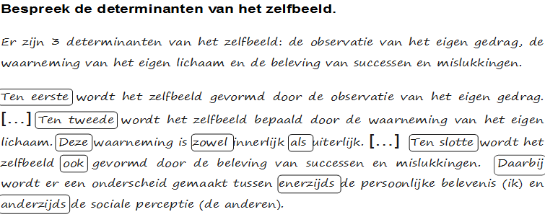
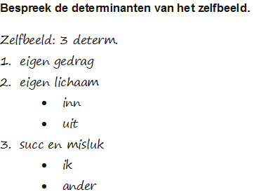
2. Targeting
Exercise: how do you note at this time?

Slide 17
2. Targeting
How to write?
8 tips for
good notes
Situate your notes
Structure your notes
Make connections
Write down in your own words
Use of abbreviations and symbols
Delete errors and leave white space if you are short on something
Indicate what is important
Work on separate sheets and number your notes

Slide 18
2. Targeting
Structure (titles, date, indents, bullets, …)
Time-saving techniques (abbreviations, symbols, arrows,…)
(!) Only use official abbreviations in reports and papers
Attention to specific specialist terms (definitions, synonyms, description)
Listen to instructions on how to approach the subject matter and point out important matters immediately
Note concisely and in your own words
Be consistent

Slide 19
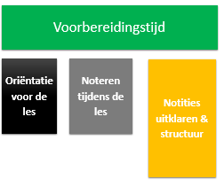
2. Targeting
2.3 AFTER the lesson
Result: notes you still understand after 8-10 weeks
Reread your notes and take your handbook, PPT, various
materials (see Processing Learning Workshop)
Readable?
Where to supplement? Organise and structure where necessary: attach title (use your table of contents as a coat hanger), underline, work with colour, keywords in margin, find links, list jargon
Unclear? Uncertain? Find out for yourself first, speak to fellow students/lectures/ask for monitorate

Slide 20
3. Conclusion
Studying is… an active process where you build knowledge using a multitude of study materials

Slide 21
Digital workshop offerings
Howest has a digital offer around study skills acquisition. This allows you to find more information when YOU need it:
Active listening and note-taking
Processiong learning materials
Structuring, diagramming, summarising and memorisation
Planning and organising
To be found on our course STUVO – Study Coaching

Slide 22
Questions?

